Slide 1
Text based Geo-locating
Jordan Nelson, Data Scientist
Notes:
What makes something distinct to your hometown? Is where you live really that different from the next town? Can you “place” what someone is talking about? All of these ideas are explored by scraping 2 subreddits and using machine learning to determine if a post can be classified as being from Washington, DC or Chicago, IL. Using machine learning, I have tuned a model to identify the contextual clues that define Washington, DC and Chicago, IL to about 90% accuracy.
If you are on reddit and are confused about what location is being discussed in the post you are reading, this model is for you! It will tell you if you are reading about Chicago or DC.

Slide 2
Agenda
Project Goal
Gathering Data
Clean & Exploring
Model Selection
Model Evaluation
Project Next Steps

Slide 3


Project Goal
Notes:
- The goal for this project was compare the reddit posts of 2 location based subreddits to determine if the machine could learn to determine location from text.

Slide 4
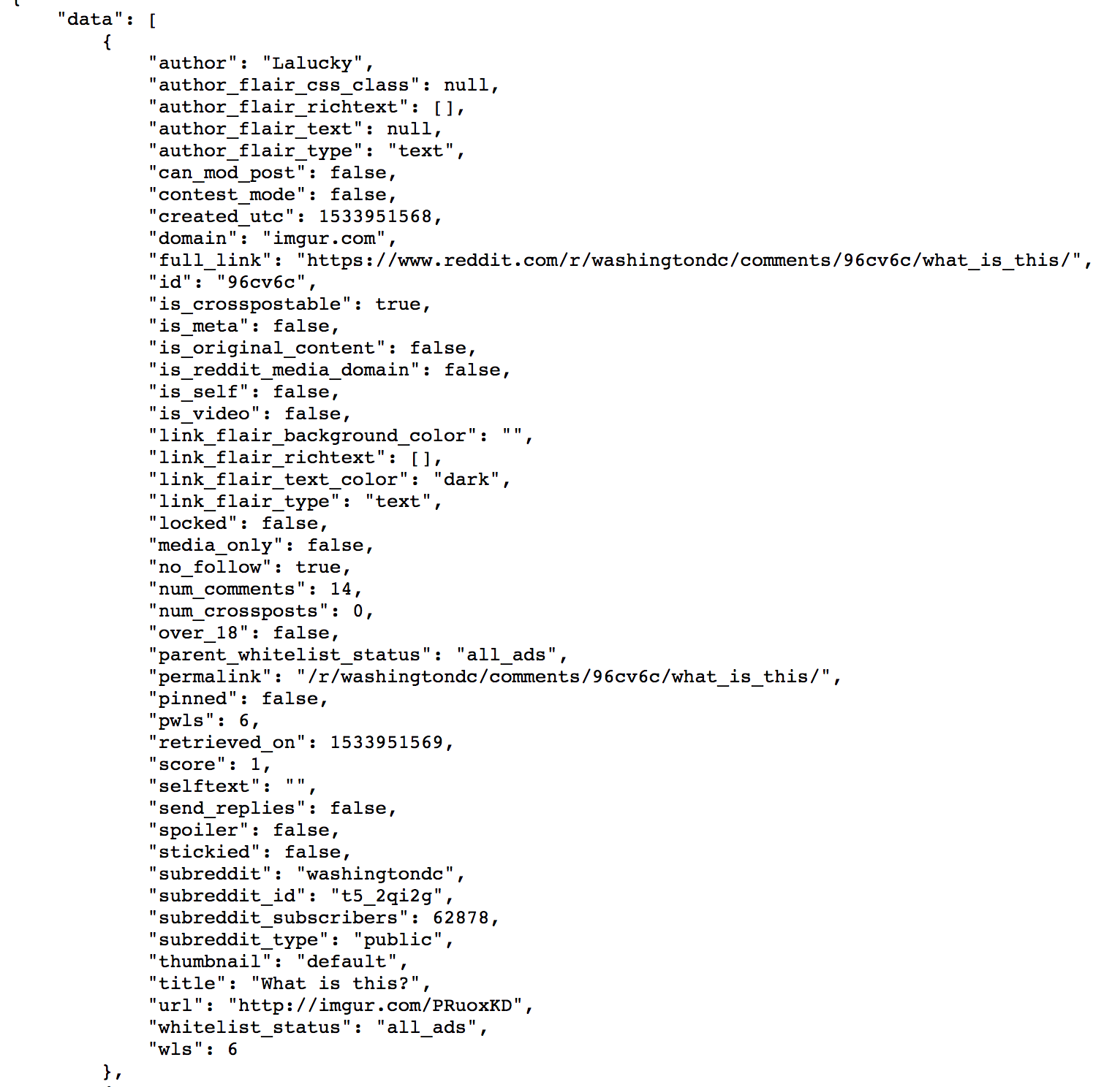
Gathering Data
Pushshift API
Function:
1000 posts
30 days
36 times
Notes:
I used the Pushshift API to scrape data from reddit.
I iterated on a function to read 1000 posts, every 30 days, for 36 iterations which yielded a 3 year time frame.
The picture shows an example of the data that was received for just 1 post.
My goal was to scrape as much data as possible.

Slide 5
Gathering the Data
 | Frequency | Relative Frequency
Chicago | 35,000 | 50.9%
DC | 33,760 | 49.1%
Unique Posts: | 68,760 | 100%
Notes:
This yielded 68,760 total unique posts.
Almost example half were from Chicago and half from DC

Slide 6
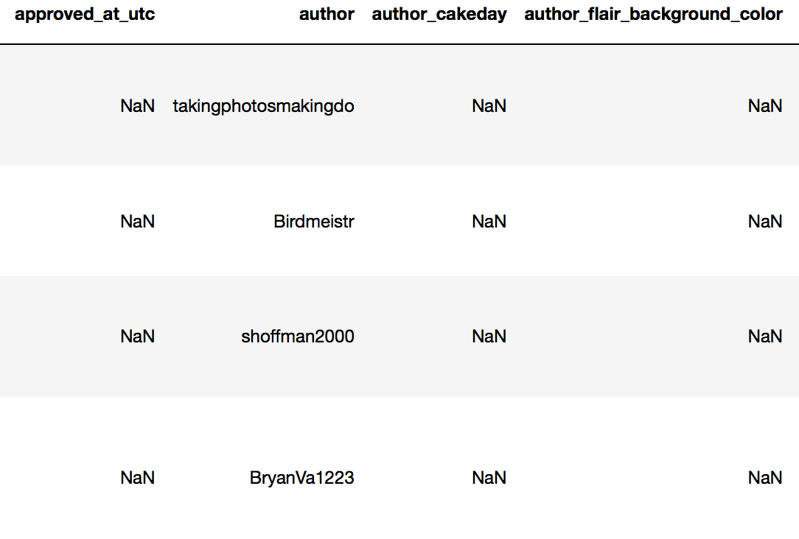
Cleaning & Exploring
78 variables
NaNs
Not relevant
4 variables, 1 target
Title
selftext
author
author_flair_text
subreddit
Notes:
Each post yielded 78 different variables and many of them contained NaNs or were irrelevant to location (approved, cakeday, background color)
In order to deal with this, I eliminated all but 4 variables.
I started by examining the title of each post, since this seemed where I might get the most information, from the least amount of content.

Slide 7
Cleaning & Exploring: title
Specific | Vague
“D.C. Statehood: Should activists go bipartisan, or try a Democratic power grab?“ | “Just moved here, a couple looking to make new friends..“
“Chicago attorney presents oral arguments limiting where gun ranges may open, judges go on offensive in Ezell V City of Chicago.” | “Star Wars Film Release”
Quick Model: accuracy of .66
Notes:
I ran a quick Logistic Regression model to see how just the title would do and it only earned a cross_val_score of 66%.
I looked into a some of the titles, and realized that some of them were likely too vague to give much information.
I need to include more text. The next best place being…the post itself.

Slide 8
Cleaning & Exploring: selftext
Post Type | Count
picture | 31744
[deleted] | 7647
[removed] | 6308
 | =45699
Notes:
I started to explore the unique types of posts and I learned that there were also a lot of NaN values here, mostly due to pictures. I filled these with the phrase picture because it didn’t seem helpful to remove ½ my data set just because the post was blank.
Additionally, there was a large chunk of posts that had been deleted or removed, however, they still had other features that were showing up.
This led me to add 2 more components that contained relevant location based information.

Slide 9
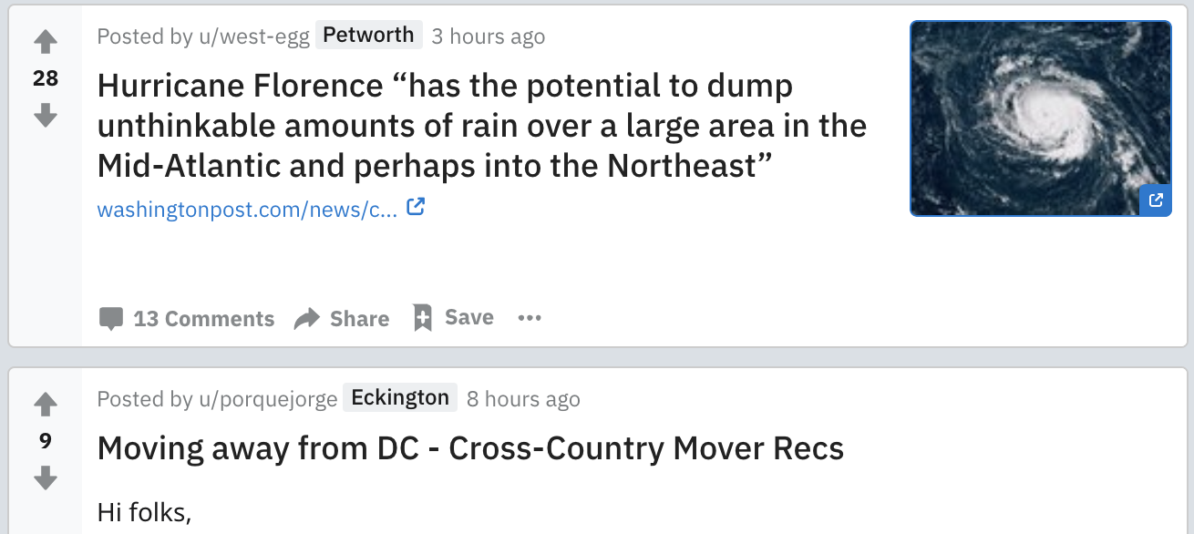
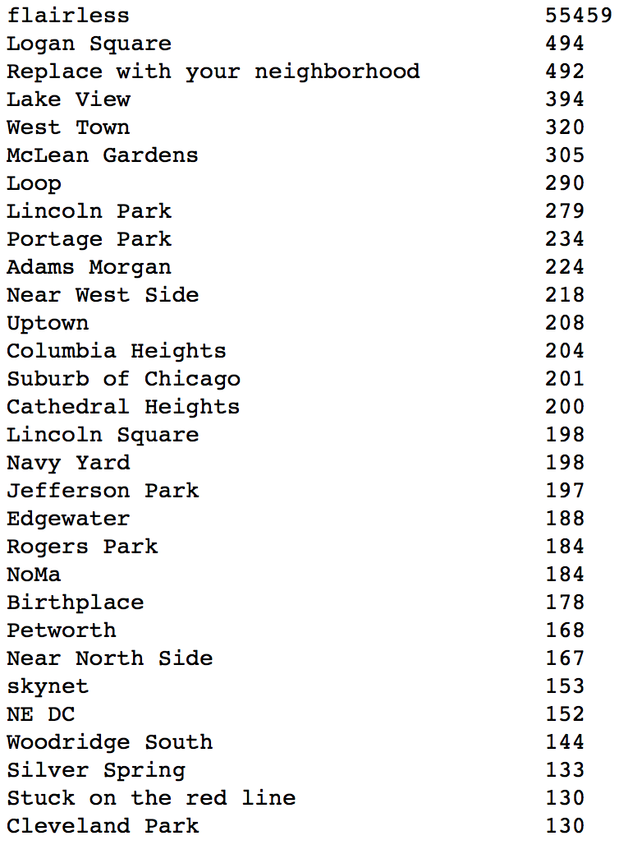
Cleaning & Exploring: author_flair_text
Notes:
- The first was the author’s flair, I noticed this when I was reading the post that some user’s had locations next to their name. This is the “author flair text”.
- While not many posts utilize this, the 10,000 or so posts that had them seemed valuable enough to add.

Slide 10
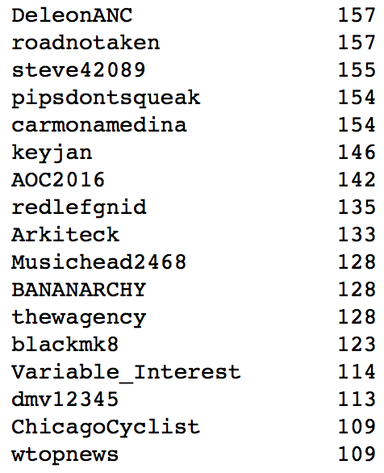
Cleaning & Exploring: author
Notes:
- The second thing I added was the actual author’s user name. Again, while many of them seemed random, there were def some that indicated a location.
- Even if they didn’t indicate a location in their name, I hoped their posting frequency would show up as significant across posts.

Slide 11
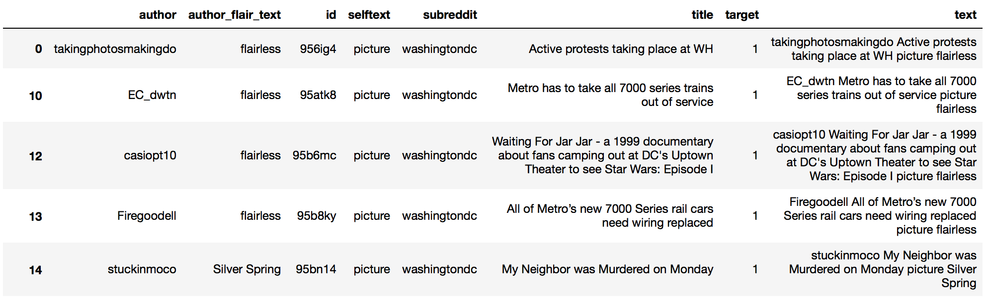
Cleaning & Exploring: combined text column
Notes:
In order to include all of these features, I created an extra column and included all 4 of these components: author, flair, title, post content.
Here’s an example of what the new column looks like for a few entries that were pure pictures. These titles and flairs allowed for classification even when post text was nonexistent.

Slide 12
Cleaning & Exploring
Count Vectorizer vs. TFIDF Vectorizer
Parameters:
words
n-grams 1-6
english stop words
minimum threshold .0008, .08%
normalized l1
1 x 4,747 sparse matrix
Notes:
Once I had the words all in one place, I took a look at a few of the different methods to count words. While both hovered around the same accuracy score (.84), countvec seemed to slightly overfit, but negligible, so I went with TFIDF.
I tested a number of parameters and ended up landing on the following parameters.
I analyzed words from 1 to 6-grams.
I used only English stop-words
I cut out the bottom .08% → without doing this my matrices were into the hundred’s of thousands.
I normalized based on l1 ****LOOK THIS UP!!!!

Slide 13
Model Selection
Model | Cross Val Score
Logistic Regression | .866
K-Neighbors | 🤯
Naïve Bayes | .880
Decision Tree | .837
Extra Trees | .817
Bagging | .852
Random Forest | .857
Gradient Boost | .823
AdaBoost | .813
SVM | .510
Notes:
- Finally I ran cross Val score on all the classification models.
All were fairly close except for KNN, which crashed and SVM, which was practically guessing.
I chose to focus on tuning my three highest models: LogReg, Naïve Bayes, Random Forest.

Slide 14
Model Selection: Tuning, Fit & Testing
Logistic Regression (.866)
L1 penalty aka Lasso (.874)
Test Score → .885
Notes:
After testing a few different parameters, I found that Lasso regularization worked best for the LogReg, rather than the default ridge.
This brought my score up to .874.
When I scored this on my test data, it went up to a .885.

Slide 15
Model Selection: Tuning, Fit & Testing
Naïve Bayes (.880)
No tuning
Test score → .885
Notes:
- I then looked at NB, to be honest, I started with multi only because I knew I only had counts. (I went back and tried gaussian, but it was a .82.)
and did it doesn’t have a lot of parameter’s to tune to begin with and nothing made an positive impact.
When I scored it on the test set it slightly increased.

Slide 16
Model Selection: Tuning, Fit & Testing
Random Forest (.857)
n_estimators from 10 to 50 (.872)
Test score → .880
Notes:
Lastly, I used rf.
I increased the n_estimators from to 50, after that it took longer and made no impact (and began to decrease).

Slide 17
Model Selection Which to choose?
Logistic Regression: .885
Naïve Bayes: .885
Random Forest: .880
Voting Classifier: .893
Notes:
Instead of choosing between these three models, I decided to let the voting classifier do it. This is where each of the models gets a 1/3 vote in the classification.
This scored the highest on my test data.

Slide 18
Model Evaluation: Pulling a New Sample
20 new posts from 9/9/2018
DC: 10/10
Chicago: 8/10
“Rugged_Turtle Odd question, anyone know what bar in the Old Town area has the best deals on vanilla vodka? picture flairless”
“I_Never_Get_Gifts I need help. I\'m really struggling right now. I have a job and everything I\'m not an unemployed mooch or a druggy or anything of that sort. I\'m a young adult. 21 years old. I really need help with making it through the week… I know this subreddit isn\'t like /r/whinykidsbegformoney but I\'m really hoping someone will help me. If not, I totally underst flairless” → [removed]
18/20 = 90%
Notes:
- I decided to pull one more sample yesterday to run through my model and gauge it’s performance.
I scraped reddit for 10 posts from each of the two subreddits.
DC scored a 10/10 for it’s posts.
Chicago got an 80% accuracy. It misclassified 2 postsL: rugged turtle and I never get gifts.

Slide 19
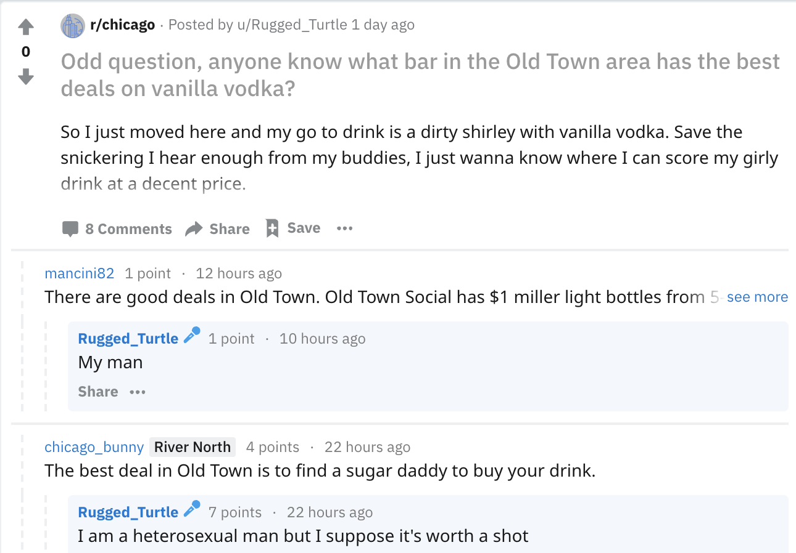
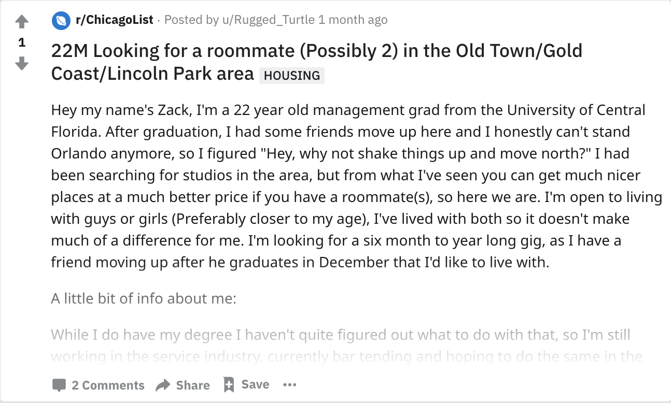
Project Next Steps
1. Scrape the post’s comments
2. Scrape author’s other posts
Notes:
Some ways to improve this model:
Since I never get gifts was removed, I focused on out old town post.
I could increase accuracy by scraping the post comments, getting the commenter’s user name and flair would have likely tipped this to Chicago.
The other thing I could have done was scraped the author’s other posts. These seems like it would be less likely to work because this guy posted in a lot of other places before posting on ChicagoList. But eventually (with a lot more processing) it would have likely worked as well.

Slide 20
Questions?

Slide 21
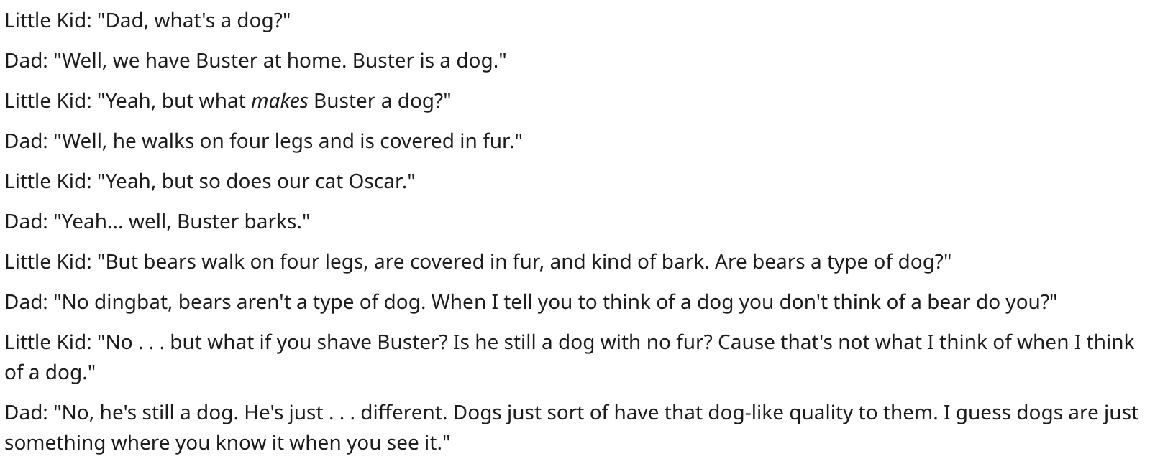
Plato's Theory of Forms

